Slide 1

Twilio Flex
In-Queue Messaging Options

Slide 2
Overview
Menu Options
Callback Request
Leave a Voicemail
Audible Alerting

Slide 3
In-Queue Messaging Menu Options
Press 1: Stay in Queue
Option to remain in queue
Press 2: Request a Callback
Press 1 to hear an menu of options
Just call be back when you can…
Press 3: Leave a Voicemail Message
Need: Provide in-queue menu options to provide contact options for caller during long queue hold times.
Record a message and route into queue

Slide 4
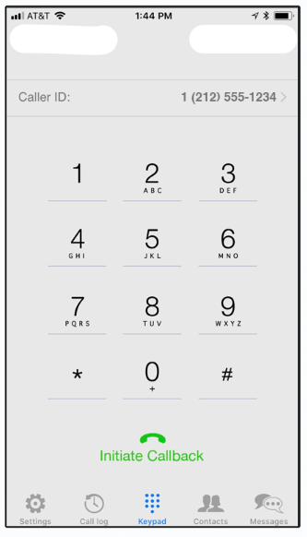
Callback Capabilities
Customer Experience Prompt: You have requested a call back at <phone number>
Press 1: Request a callback at the number provided (inbound phone number)
Press 2: Request a callback to a different number

Slide 5
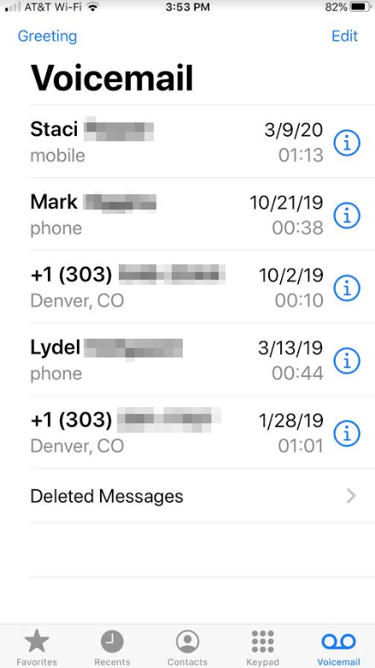
Voicemail Capabilities
Customer Experience Prompt: At the sound of the tone leave a voicemail message
Call is recorded;
Call is transcribed
Voicemail (task) is routed to agent

Slide 6
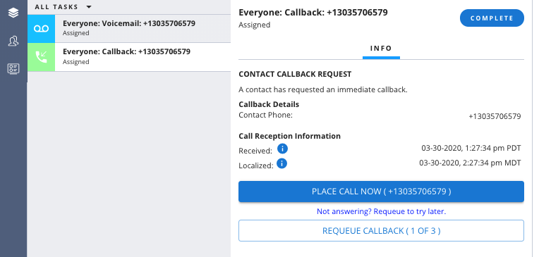
Flex Agent UI: Callback
Agent UI experience
Call Back Request Information
Contact Phone (ANI)
Time Call Received by Flex
Call time localized to agent local
Call Back Actions
Place Call – Initiate callback
Requeue callback Callback failed – no response

Slide 7
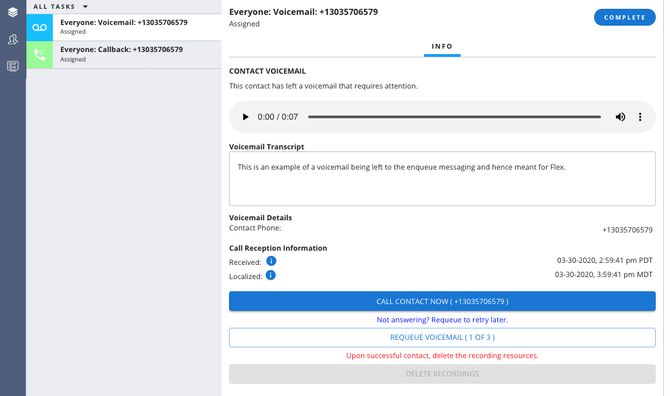
Flex Agent UI: Voicemail
Agent UI experience
Voicemail Request Information
Contact Phone (ANI)
Time Call Received by Flex
Call time localized to agent local
Audio Player
Recording Transcript
Call Back Actions
Place Call – Initiate callback
Requeue callback Callback failed – no response
Delete Recordings

Slide 8
Callback & Voicemail
Task Re-Queueing
If the Call Contact Fails
Submit Task to Try Again (Re-Queue)
Task submitted onto original workflow
Workflow Filters:
Configurable Time Delays
Configurable Priority Routing
Re-Queue up to three (3) times

Slide 9
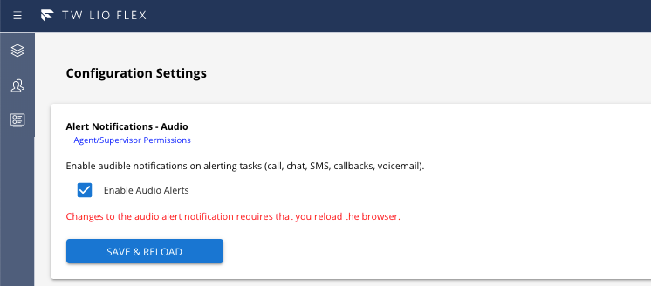
Audible Task Alerting
Agent Experience Notifications
As the Task Alerts
Provide a configurable audio sound
Alert the agent to a new inbound task
Configurable by agent (browser ‘localstorage’ usable)

Slide 10
Notes:
The foundation of the Twilio Customer Engagement Platform is the Super Network, which is where we manage the connections to the telecommunications global network, and between it and the internet. The Super Network allows developers to focus on building applications while we handle the deep complexity of how to send communications that can reach billions of people worldwide with levels of redundancy, reliability, and security no one else can approach. We do it even for the Internet of Things.
Leveraging the Super Network, we interconnect the world with programmable Channel APIs--Voice, Text, and Email, along with other channels such as Facebook Messenger and WhatsApp.
Twilio is different than others who offer programmable channel APIs because we offer Identity, Intelligence, and Orchestration Services that give you the power to create engagement that makes a difference to your customers, while saving development time.
We also offer solutions to accelerate the most common use cases such as contact center and marketing campaigns. The Flex contact center solution is a new type of software called an application platform, which is an out of the box product like a SaaS app, but with the full programmability of APIs so you can customize any aspect of it to meet the specific needs of your business.
We support the platform with a rich set of Runtime tools to maximize productivity and time to market.

